Slide 1

Weekly Review
13/04/21
Tasks
Updated rewards to include positive values ✅
Understand intuition behind SAC ⚠️In progress
Conduct experiments and evaluate results using GUI and plots ⚠️In progress
Problems
Results of experiment still not improved
To-Do Items for Next Week
Compare organization of current repo with RLPYT original repository
Update states, values, rewards till you get
Define more reward functions, states, actions for our use case
To-Do Later
Explore usage of intermediate testing on simulation before sim-to-real transfer
Define use-case (for different type of towels (colour, texture, etc. ) / one type )

Slide 2
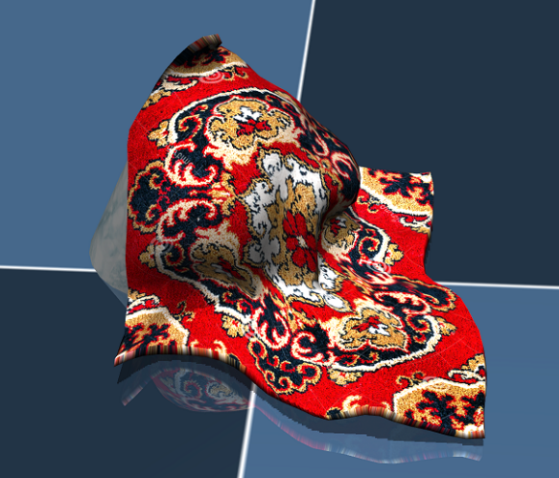
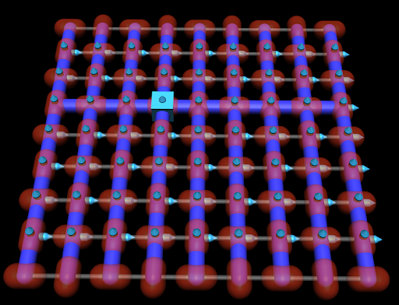
RL Problem for obtaining one flat seam
13/04/21
Goal
Obtain one flat seam
Given
Cloth in mujoco represented by 64 particles in 8*8 grid
Observations
[x,y,z] positions of 4 points adjacent to corner 1
Actions
Random [x,y] movement of corner 1
Corner 1

Slide 3
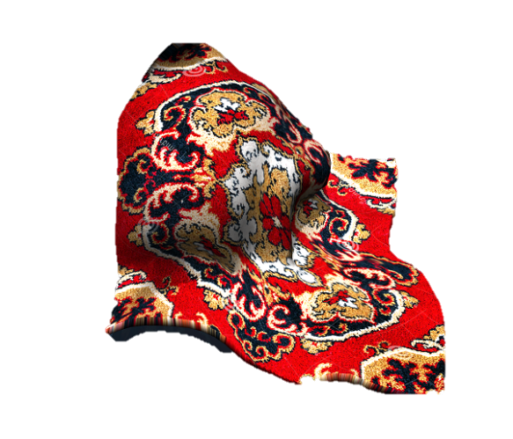
RL Problem for obtaining one flat seam
13/04/21
Goal
Obtain one flat seam -> Corner particle + 3 adjacent particles in a straight line
Reward
Join 1st point and last point
Project on x,y plane
3. Reward is proportional to :
(1 -1 * (x,y,z) distance from the ideal line)*10
Step 1
Step 2
Updated reward
X
X
X
X
0.3
0.3
0.3
Step 3
z = 0

Slide 4
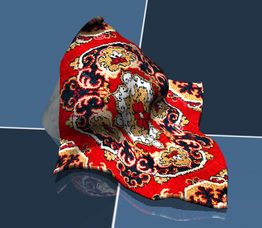
STEP 1 : Sample actions from value network and store state, action, reward, next state, done in Experience Replay Buffer
State -> Actor Network -> Action
State, action -> Critic Network 1 ->
Quality of action
State, action -> Critic Network 2 -> Quality of action
State -> Value Network -> Value
State, action -> Target Value Network -> Value
Separate V and Q networks help in convergence
Action sampled
From mean, variance
Value
Network
( ψ)
Target
Network
( ψ)
Policy
Network
(ϕ)
Critic 1
Network
(θ)
Critic 1
Network
(θ)
ExperienceReplay
Buffer
High Entropy
Maximize Exploration
Equal probabilities to
Actions that have same or nearly same Q-values
Maximize the reward + entropy of the policy
State, action, reward, next state, done
SAC Agent
Action
Pick point
Place point
Observation
(64*64 img)
Environment (Mujoco)

Slide 5
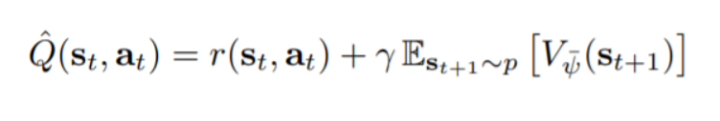
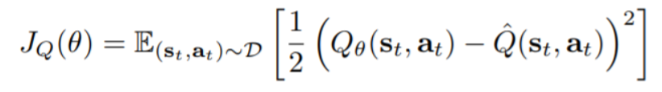
STEP 2 : We train the Quality Network by minimizing the following error
State -> Actor Network -> Action
State, action -> Critic Network 1 ->
Quality of action
State, action -> Critic Network 2 -> Quality of action
State -> Value Network -> Value
State, action -> Target Value Network -> Value
Separate V and Q networks help in convergence
Value
Network
( ψ)
Target
Network
( ψ)
Policy
Network
(ϕ)
Critic 1
Network
(θ)
Critic 1
Network
(θ)
ExperienceReplay
Buffer
Two networks are taken to avoid overestimation of Q values
High Entropy
Maximize Exploration
Equal probabilities to
Actions that have same or nearly same Q-values
Maximize the reward + entropy of the policy
State, action, reward, next state, done
SAC Agent
Action
Pick point
Place point
Observation
(64*64 img)
Environment (Mujoco)

Slide 6
STEP 3 : We train the Value Network by minimizing the following error
State -> Actor Network -> Action
State, action -> Critic Network 1 ->
Quality of action
State, action -> Critic Network 2 -> Quality of action
State -> Value Network -> Value
State, action -> Target Value Network -> Value
Separate V and Q networks help in convergence
Value
Network
( ψ)
Target
Network
( ψ)
Policy
Network
(ϕ)
Critic 1
Network
(θ)
Critic 1
Network
(θ)
ExperienceReplay
Buffer
High Entropy
Maximize Exploration
Equal probabilities to
Actions that have same or nearly same Q-values
Maximize the reward + entropy of the policy
State, action, reward, next state, done
SAC Agent
Action
Pick point
Place point
Observation
(64*64 img)
Environment (Mujoco)

Slide 7
STEP 4 : We update the Target Network
State -> Actor Network -> Action
State, action -> Critic Network 1 ->
Quality of action
State, action -> Critic Network 2 -> Quality of action
State -> Value Network -> Value
State, action -> Target Value Network -> Value
Separate V and Q networks help in convergence
Lags the Value Network
Value
Network
( ψ)
Target
Network
( ψ)
Policy
Network
(ϕ)
Critic 1
Network
(θ)
Critic 1
Network
(θ)
Target for Q Network depends on V Network and vice versa
ExperienceReplay
Buffer
High Entropy
Maximize Exploration
Equal probabilities to
Actions that have same or nearly same Q-values
Maximize the reward + entropy of the policy
State, action, reward, next state, done
SAC Agent
Action
Pick point
Place point
Observation
(64*64 img)
Environment (Mujoco)

Slide 8
Intuition behind SAC (In progress …)
13/04/21
Take actions based on initialized weight for 250 steps
Store observations, actions, next observations, rewards in Replay Buffer (Batch 250)
State, action pairs are fed to Critic network
Critic network judges the quality of state-action pairs based on reward for that step + target value, i.e. if reward and target value are good, the pair is good
Quality network feeds the Value network
Value network output is the Critic network output – entropy term (which depends on action)
Value network updates the weights of the Policy network
Policy network learns to predict good actions
In progress …

Slide 9
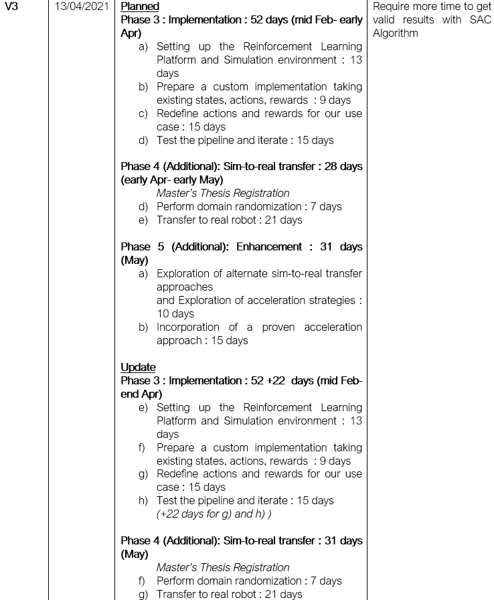
Plan updation
13/04/21

Slide 10
Plan updation
13/04/21

Slide 11
THANK YOU

